Slide 1
LLM (Large Language Models)
Large Language Models (LLMs) are a subset of machine learning models designed to generate and understand human language. They are built using deep learning techniques, typically focusing on natural language processing (NLP) tasks such as text generation, summarization, translation, and answering questions.
LLMs are trained on vast amounts of text data, learning to predict the next word in a sequence (token prediction) or generate sentences, paragraphs, and even entire articles. Examples of LLMs include GPT (Generative Pretrained Transformer), BERT (Bidirectional Encoder Representations from Transformers), and T5 (Text-To-Text Transfer Transformer).
Core Characteristics of LLMs:
Pretrained on large datasets: LLMs are trained on extensive text corpora to learn the syntactic and semantic patterns of human language.
Transformer architecture: LLMs are usually based on the Transformer architecture, which leverages self-attention mechanisms to understand the relationships between words in a sequence.
Fine-tuning: After pretraining, LLMs can be fine-tuned on task-specific datasets to improve performance on specific problems.

Slide 2
How to Train an LLM
Step-by-Step Process:
Data Collection and Preprocessing:
Collect large-scale text data related to the domain you're targeting.
Clean the data (remove unwanted symbols, correct formatting) and tokenize it (split into words or subwords).
Model Architecture Selection:
LLMs typically use the Transformer architecture.
Define the model's architecture: number of layers, attention heads, hidden units, etc.
Pretraining:
Pretrain the LLM by feeding large amounts of unsupervised text data to the model. The objective is usually language modeling: predicting the next token in a sequence.
Fine-tuning:
After pretraining, fine-tune the model on a smaller, labeled dataset specific to the target task (e.g., question answering or text summarization).
Evaluation:
Evaluate the model using metrics like perplexity (for generation tasks), F1 score, BLEU score, or accuracy, depending on the application.
Key Components of Training:
Optimizer: Adam or AdamW is commonly used for optimizing large models.
Learning Rate: Often a warm-up and decay strategy is used.
Hardware: LLM training requires high-performance GPUs or TPUs due to the extensive computational needs.

Slide 3
LLMs VS General Deep Learning Models
Aspect | LLMs | General Deep Learning Models
Architecture | Transformer architecture (self-attention) | CNNs (convolutions) for images, RNNs for sequences
Data Requirement | Trained on massive, often unsupervised text datasets | Often trained on smaller, task-specific datasets
Application | Text generation, summarization, translation | Image classification, object detection, etc.
Pretraining and Fine-tuning | Involves large-scale pretraining followed by fine-tuning | May directly train on task-specific data
Scalability | Scales with more data and compute | Limited by data availability and task complexity
Multi-modal capabilities | Can be extended to handle multiple types of input (text, images) | Often single modality per model type

Slide 4
Implementing a Generative Model in Bioinformatics
LLMs can be adapted to bioinformatics tasks such as generating protein sequences, predicting gene interactions, or generating synthetic data based on bioinformatics datasets. Below is a demo for training an LLM-based model for sequence generation in bioinformatics.
Data Collection & Preprocessing
Tokenization
Model Setup (Pretrained Model)
Fine-tuning on Data
Sequence Generation (DNA/Protein)
Evaluation

Slide 5
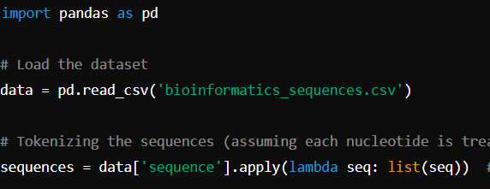
Pipeline for LLM Implementation in Bioinformatics
Step 1: Data Preparation
First, we collect bioinformatics data like DNA or protein sequences from datasets such as FASTA files.

Slide 6

Step 2: Model Setup
We'll use a simple transformer model for sequence generation. for DNA sequences, we can adapt the tokenizer to handle A, T, C, G nucleotides instead of words) tokenizer = GPT2Tokenizer.from_pretrained('gpt2') Custom tokenizer (if dealing with DNA sequences specifically)
tokenizer.add_tokens(['A', 'T', 'C', 'G'])
Load a pretrained GPT-2 model for sequence generation
model = GPT2LMHeadModel.from_pretrained('gpt2')
Adjust the model to handle the new vocabulary size
model.resize_token_embeddings(len(tokenizer))
Tokenize the sequences for input to the model
inputs = tokenizer(sequences.tolist(), return_tensors='pt', padding=True, truncation=True)

Slide 7
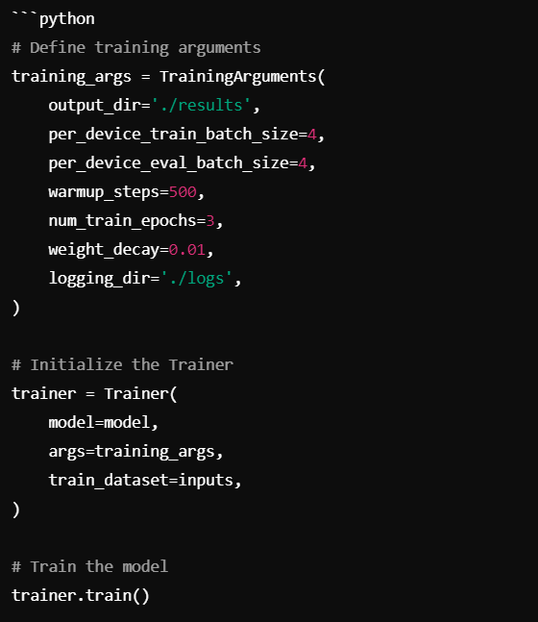
STEP-3

Slide 8
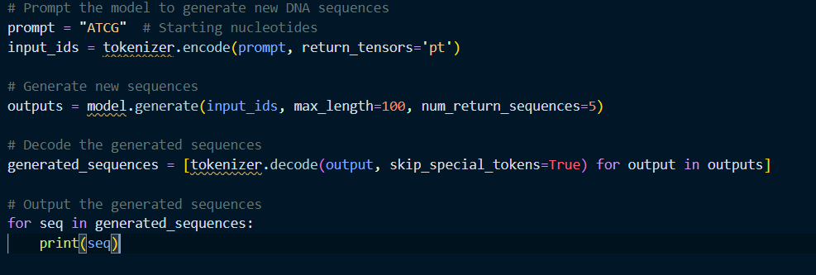
Step 4: Generating New DNA Sequences
After training, we can use the fine-tuned model to generate new DNA sequences based on the learned patterns.

Slide 9
Data Preparation:
We start by loading the bioinformatics dataset and preprocessing the sequences. DNA or protein sequences are tokenized, with each nucleotide (A, T, C, G) treated as a token. Tokenization transforms the sequences into numerical representations that the model can process.
Model Setup:
A pretrained language model (GPT-2 in this case) is adapted for bioinformatics tasks by extending its tokenizer to handle the DNA alphabet.
The model is resized to accommodate the expanded vocabulary, which includes the specific nucleotides.
Training:
The GPT-2 model is fine-tuned using the bioinformatics dataset. The training process updates the model's weights based on the patterns in the DNA sequences.
Training arguments define parameters like batch size, number of epochs, learning rate warmup, and logging configurations.
Generation:
Once trained, the model can generate novel DNA sequences. By providing a short DNA sequence as a prompt, the model predicts the next nucleotides based on its learned knowledge, generating new sequences with desired lengths.
Evaluation and Use in Bioinformatics:
Generated DNA sequences can be evaluated for biological relevance, potentially aiding in synthetic biology or genomics research by proposing new candidate sequences for lab testing.

Slide 10
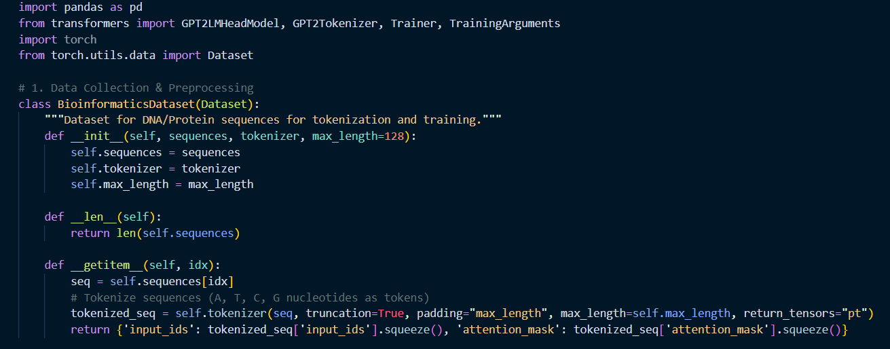
Code For Pipeline

Slide 11
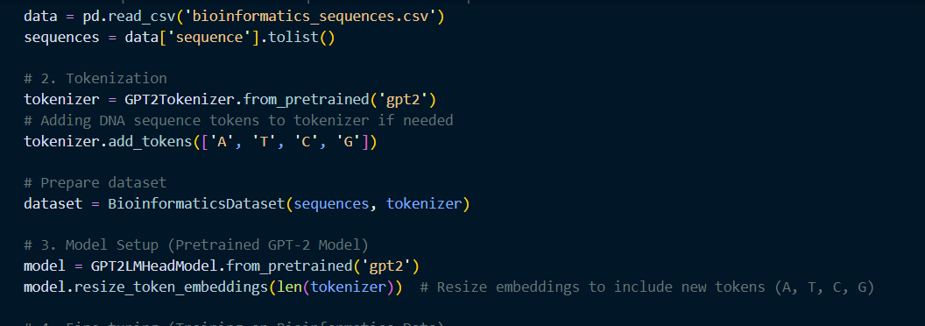

Slide 12
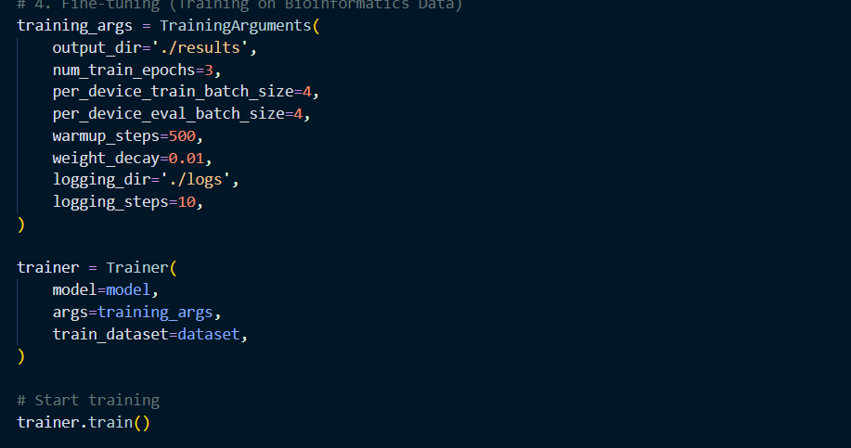

Slide 13
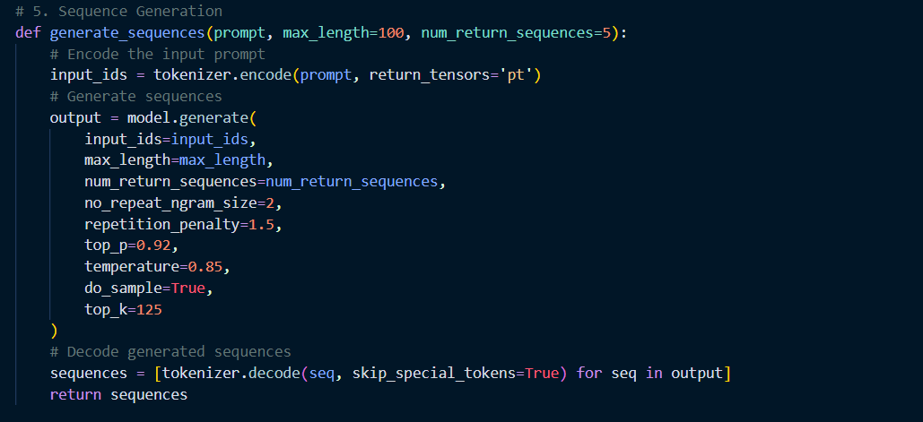

Slide 14
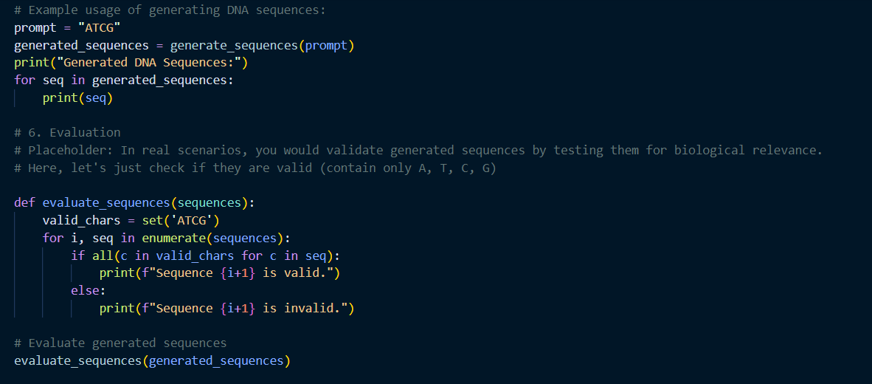

Slide 15
Conclusion
By leveraging LLMs in bioinformatics, we can generate biologically relevant sequences, predict interactions between biomolecules, or assist in protein folding tasks. The flexibility of LLMs allows them to be adapted to various domains, including bioinformatics, where understanding complex biological data can benefit from the power of deep language modeling.
This pipeline provides a foundation for applying LLM-based generative models to bioinformatics problems, while also illustrating how to fine-tune and use models like GPT for domain-specific applications.

